Slide 1
The Linux Command Line Chapter 5
Working With Commands
Prepared by Dr. Reyes, New York City College of Technology

Slide 2
What Exactly Are Commands?
An executable program such as compiled binaries written in C and C++ or programs written in scripting languages such as the shell, python, ruby, etc.
A command built into the shell itself
i.e. cd
A shell function. (Covered later in the course)
An alias. Commands that we can define ourselves, built from other commands.

Slide 3

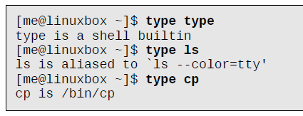
type command
type - displays the kind of command the shell will execute, given a particular command name

Slide 4

which command
which - command used to determine the exact location of a given executable.
Only works for executable programs, not built-ins nor aliases

Slide 5
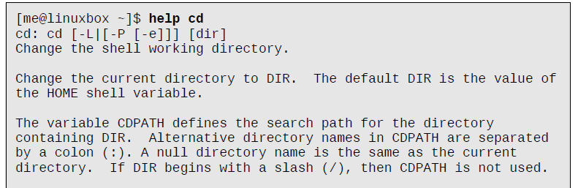
help command
help – displays basic information about a command

Slide 6

man command
man - displays the manual of a command.
A manual is a comprehensive documents with all the details and options supported by the command. Very technical documents.

Slide 7
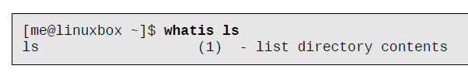
whatis command
whatis - displays the name and a one-line description of a man page matching a specified keyword.

Slide 8

info command
info - an alternative command to man pages that is more user friendly.

Slide 9

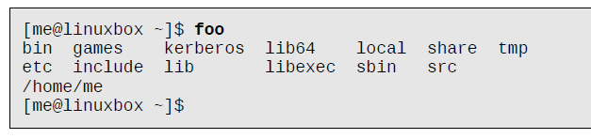
alias command
Used to create your own composite commands
Usage: alias name=‘command1; command2; … ; commandN‘
Using alias:

